Slide 1
CST2550 Coursework 1

Slide 2
Introduction
Student Number: M00737296
The project was to make a stock system for a music shop and to demonstrate what we have learnt in this module in order to make the stock system.
In this project I have created a stock system which completes the tasks within the coursework sheet.
Within the presentation I will be going through:-
- Software design (description of my work and UML diagrams)
- Software testing
- description of approach
- How the Makefile and version control were used
- limitations and critical reflection

Slide 3
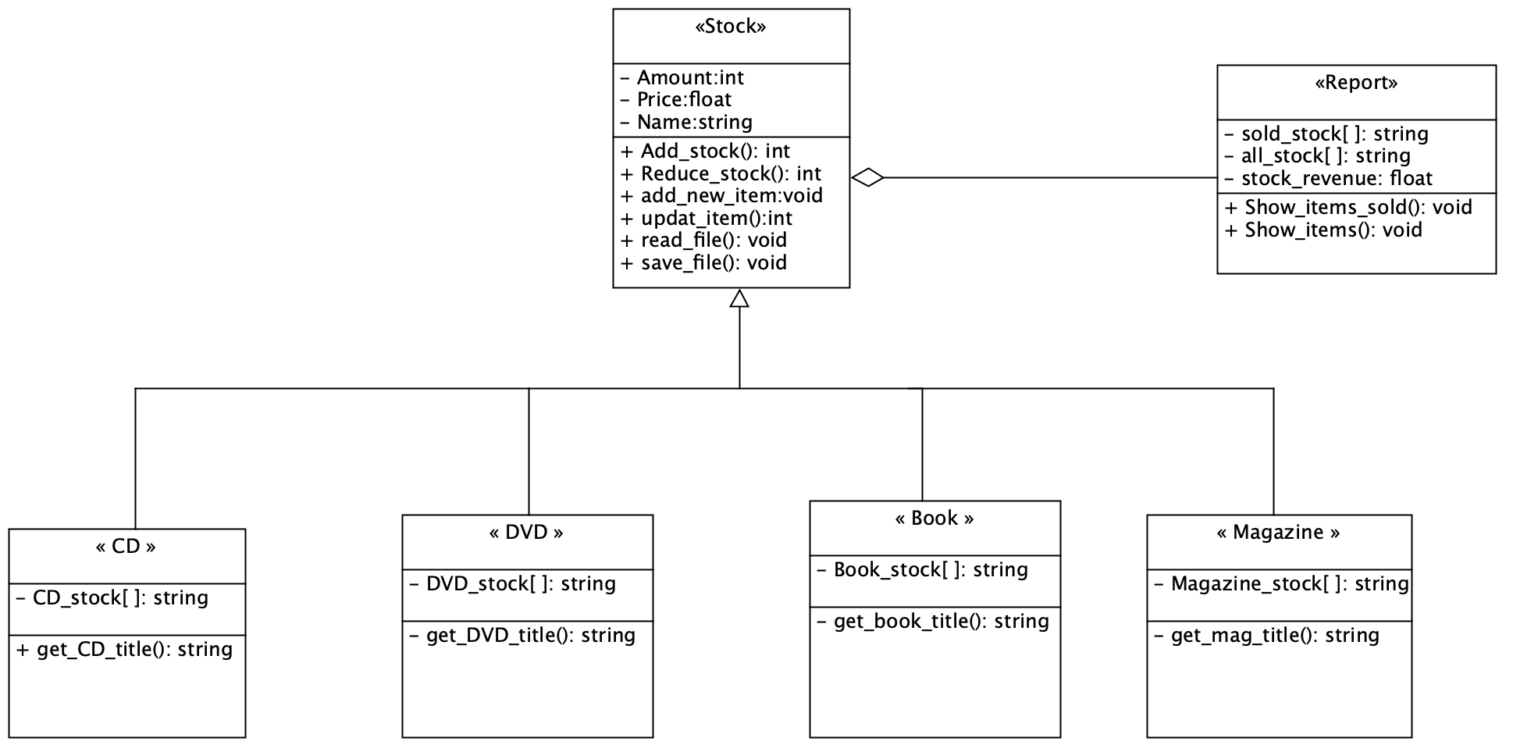
Uml diagrams- class
Before starting the project, I had little knowledge on how to build the system and this led me to create my first draft of a class diagram:-
Unfortunately, I did not use this diagram since after doing huge amount of research I have chose to create the stock system with one class.

Slide 4
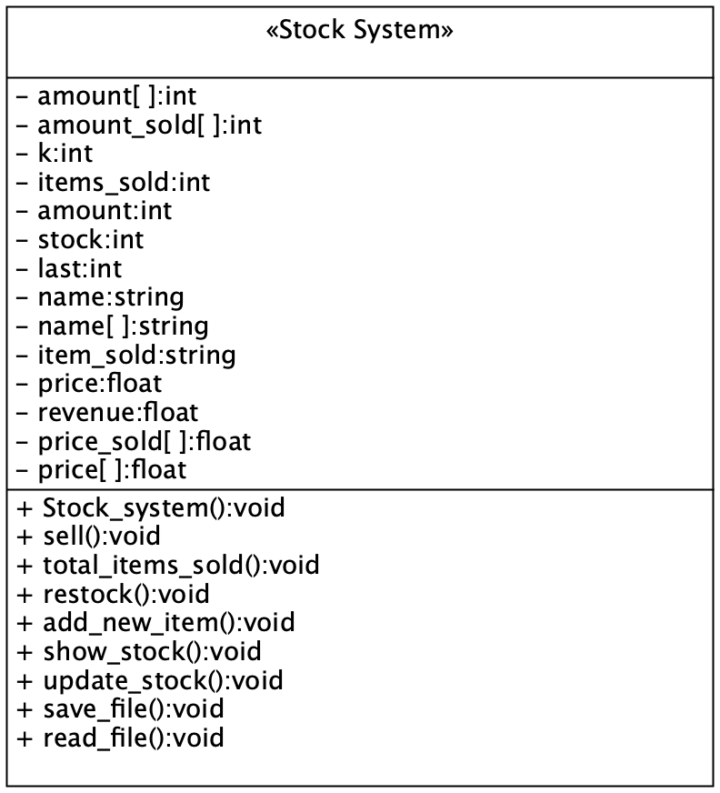
This is the class that I have used to create my stock system.
As you can see there are many private member variables and public member functions. My plan was to use the functions to alter the arrays (within the private member variables).

Slide 5
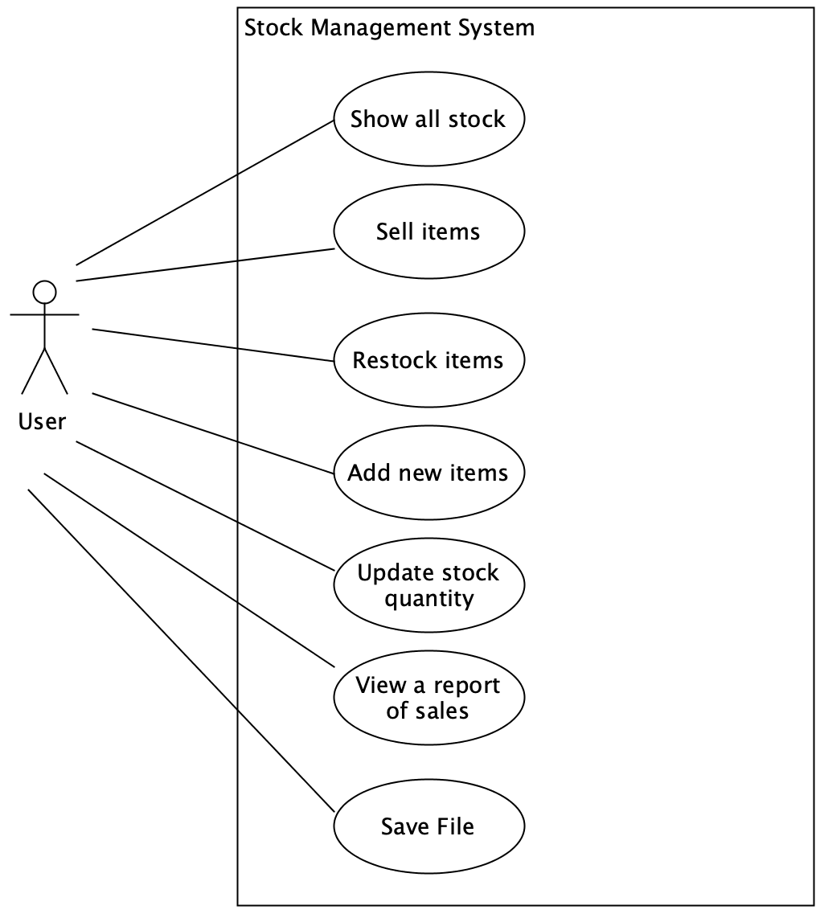
UML diagram- use case
The use case diagram relates to my stock system since it shows functionality of the system and Describes actors who interact with the system.
It was written From the point of view of the actor
This is portrayed in my system since as the user loads the system they are greeted with the following options (shown in the Use case diagram)

Slide 6
Use case: Sell items
Brief description: A user chooses a stock and sells the stock
Primary actors: User
Secondary actors: None
Preconditions: The user activated the stock system
Main flow: 1. User inputs a stock 2. User inputs the number of stocks to sell 3. System sells the stocks
Postconditions: stock quantity reduced.
Alternate flows: User inputs invalid stock name or number, stock will not be affected.

Slide 7
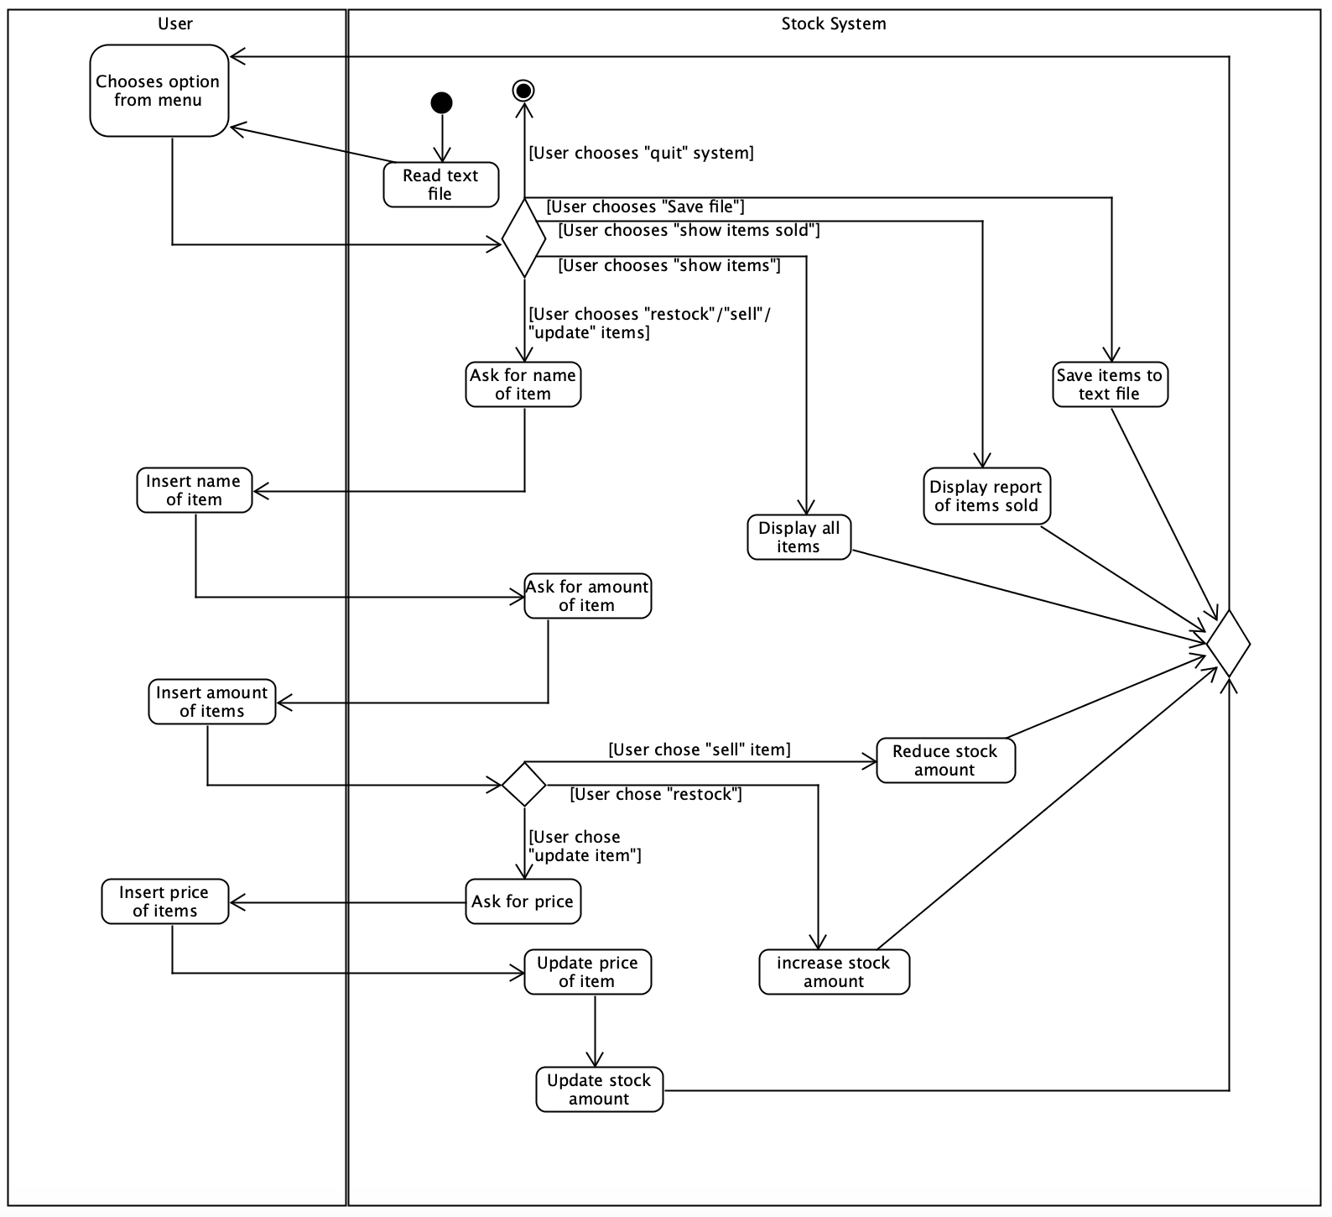
UML diagram- Activity diagram
Activity diagram Shows flow between one action and next action with arrows.
In this diagram it shows the stock system has the initial node. After reading the text file the system stores the stocks from the text file. The user then chooses an option. These option merges and returns back to the user picking another option creating a loop. The system ends when the user chooses “quit”.
I used this activity diagram as a guide when making my stock system and I have included everything in this activity diagram in my stock system.

Slide 8
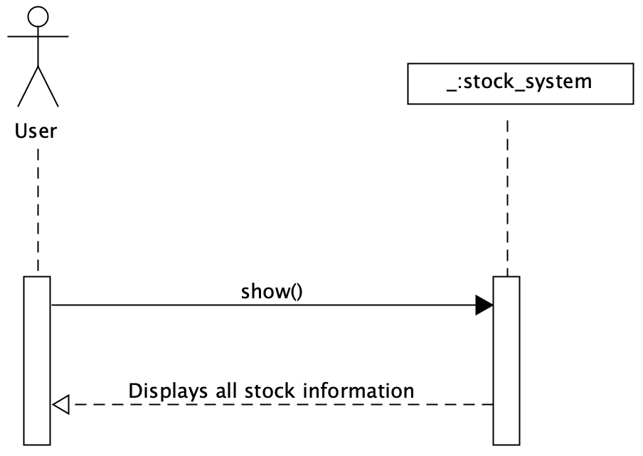
UML diagram- Sequence diagram (show function)
For this project I have created a sequence diagram for each function that I have in my stock system.
This showed me how classes and objects interact with each other. It also shows the order of interactions.
Here is the “show” function sequence diagram.

Slide 9
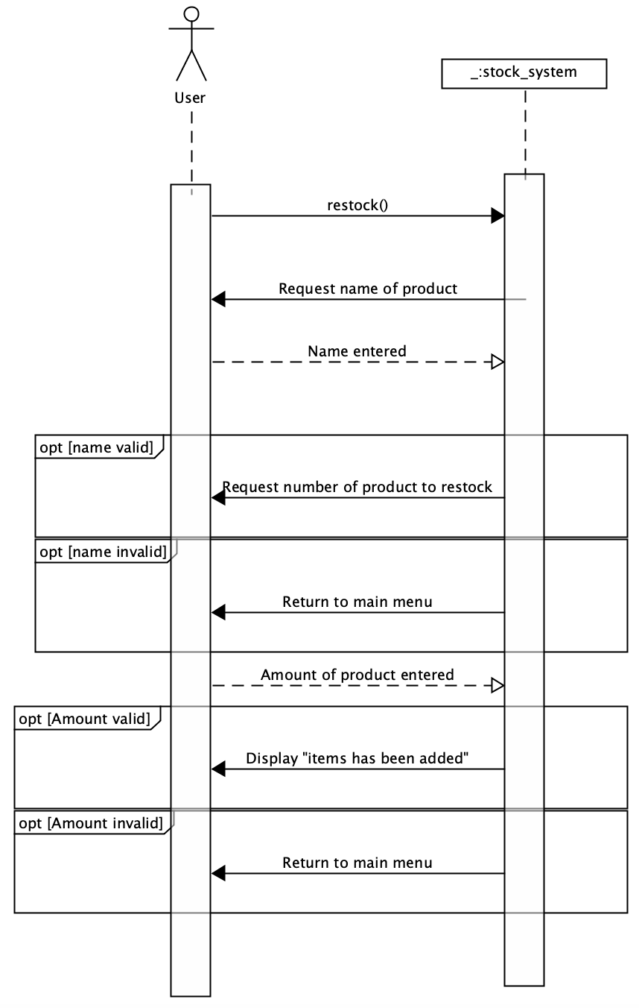
Sequence diagram (restock function)
Restock sequence diagram shows the order of interaction between the user and stock system when the restock function is called.
As you can see this function request name and number of item in order to add items to a specific stock and if the user fails to input valid information the item returns to “main menu”.
This also helped me within my stock system (code) since it provided with a guide in what to include in the function. For example, it helped me to notice the validation of the function).

Slide 10
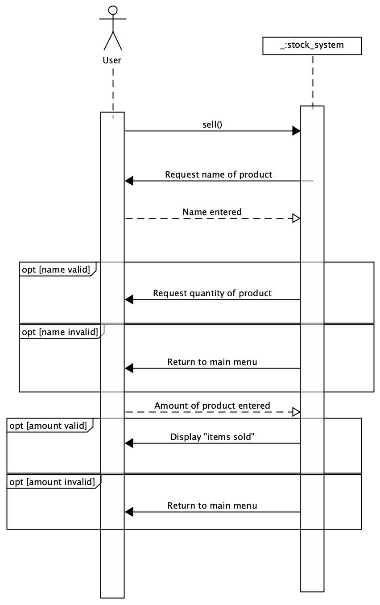
Sequence diagram (sell function)
This is very similar to the restock function.
This shows the order of events that take place when the sell function is called.
As you can see this function request name and number of item in order to sell (reduce) items within a specific stock and if the user fails to input valid information the item returns to “main menu”.
The diagram also helped me make the function within my code. This can be seen within the code since I included everything that is in this diagram.

Slide 11
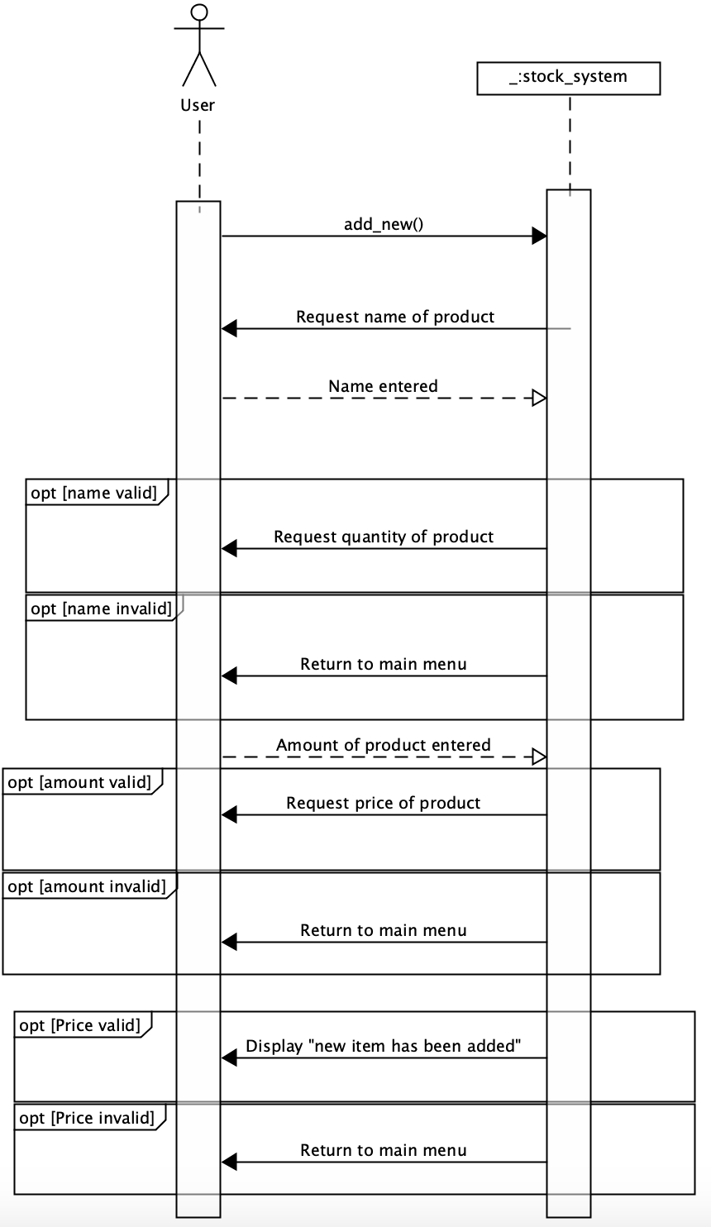
Sequence diagram (new item function)
This diagram shows the order of interaction between the user and stock system when the add new item function is called. This function adds a new item to the stock.
As you can see the stock system requests name, number and price from the user. If the user gives invalid input, the system returns to main menu. If the user is successful, the system displays a message.

Slide 12
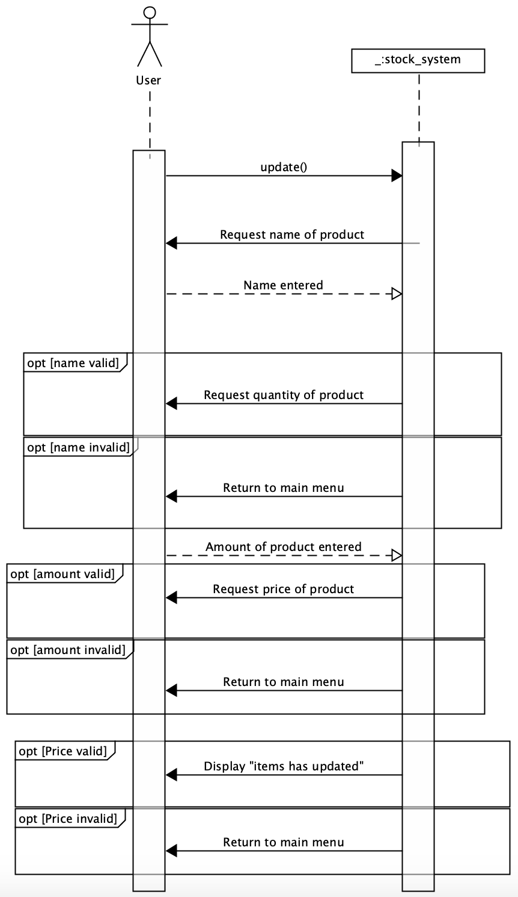
Sequence diagram (update function)
This diagram shows the order of interaction between the user and stock system when the update function is called. This function updates the number and price of an item.
As you can see the stock system requests name, number and price from the user. If the user gives invalid input, the system returns to main menu. If the user provided with correct inputs the system displays a message.

Slide 13
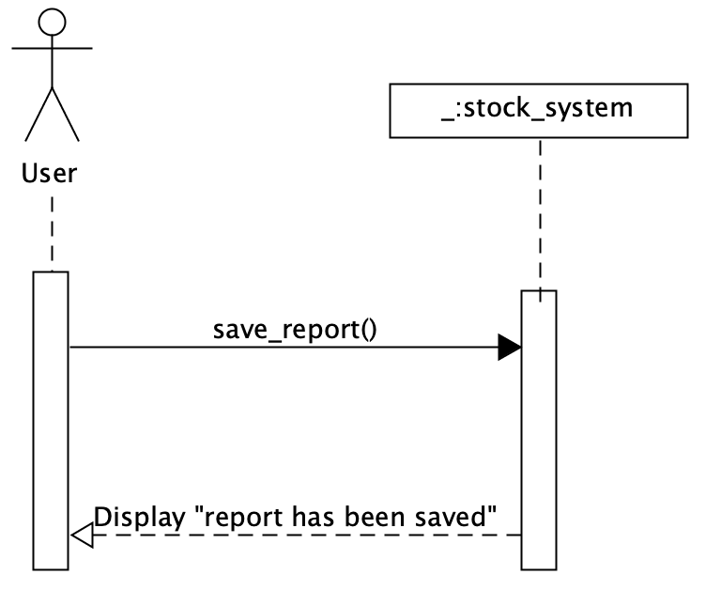
Sequence diagram (Save report function)
This diagram shows the save report function (saves the stock information in a text file).
As you can see when the user calls the save report function, the stock system simply displays a message.

Slide 14
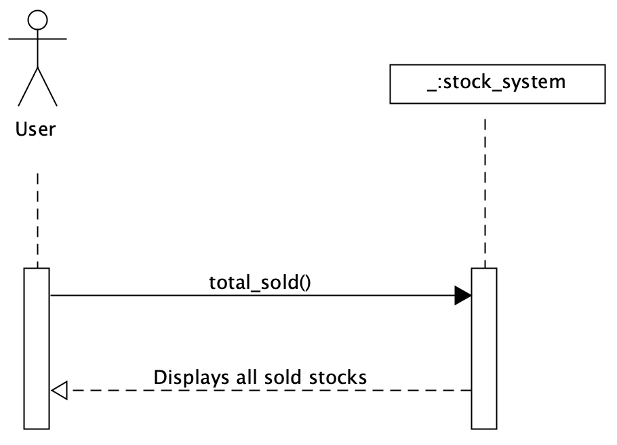
Sequence diagram (total sold function)
This diagram shows the total sold function which displays a report for all the stock that have sold.
As you can see when the user calls the total sold function, the stock system simply displays all stock that has sold.

Slide 15
Software testing
Type of testing I have used is:-
- Development Testing
- User Testing

Slide 16
Development Testing
Unit testing - test individual functions, methods, classes.
For this I used assertion.
before I ran the program, I predicted what each function will do. For example, after completing the restock function I predicted the outcome of the function. If the outcome was different from my prediction, I then revisit the code.
Component testing - Is to test if the functions, methods, classes interacted properly.
I have done this by running the program for every function I created, and I made sure there was no errors or warnings.

Slide 17
User Testing
Alpha - When early version of software is released to small group
This was done by asking few students to try my system.
Beta - When software is released more widely. And is tested for errors before actual release.
I then ask few more students to try find errors within the system. In which they have, found errors, within the validation of the system when inserting a negative number for the price. This made me revisit my code and fix the error. This can be seen within the commits.
Acceptance testing - When customer test software to meet requirement and does everything correctly.
After correcting the validation students confirmed the requirement was met.

Slide 18
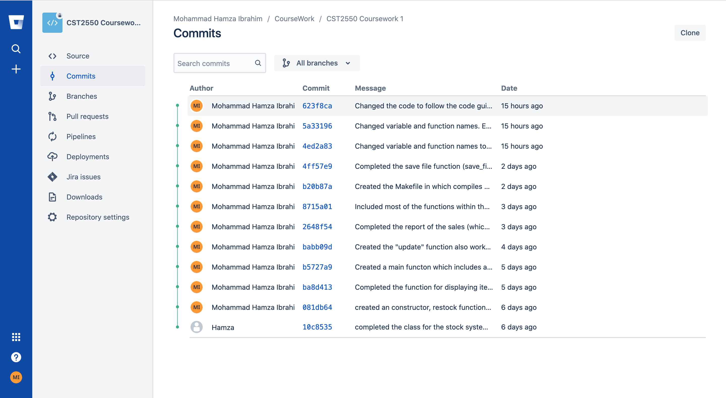
commits

Slide 19
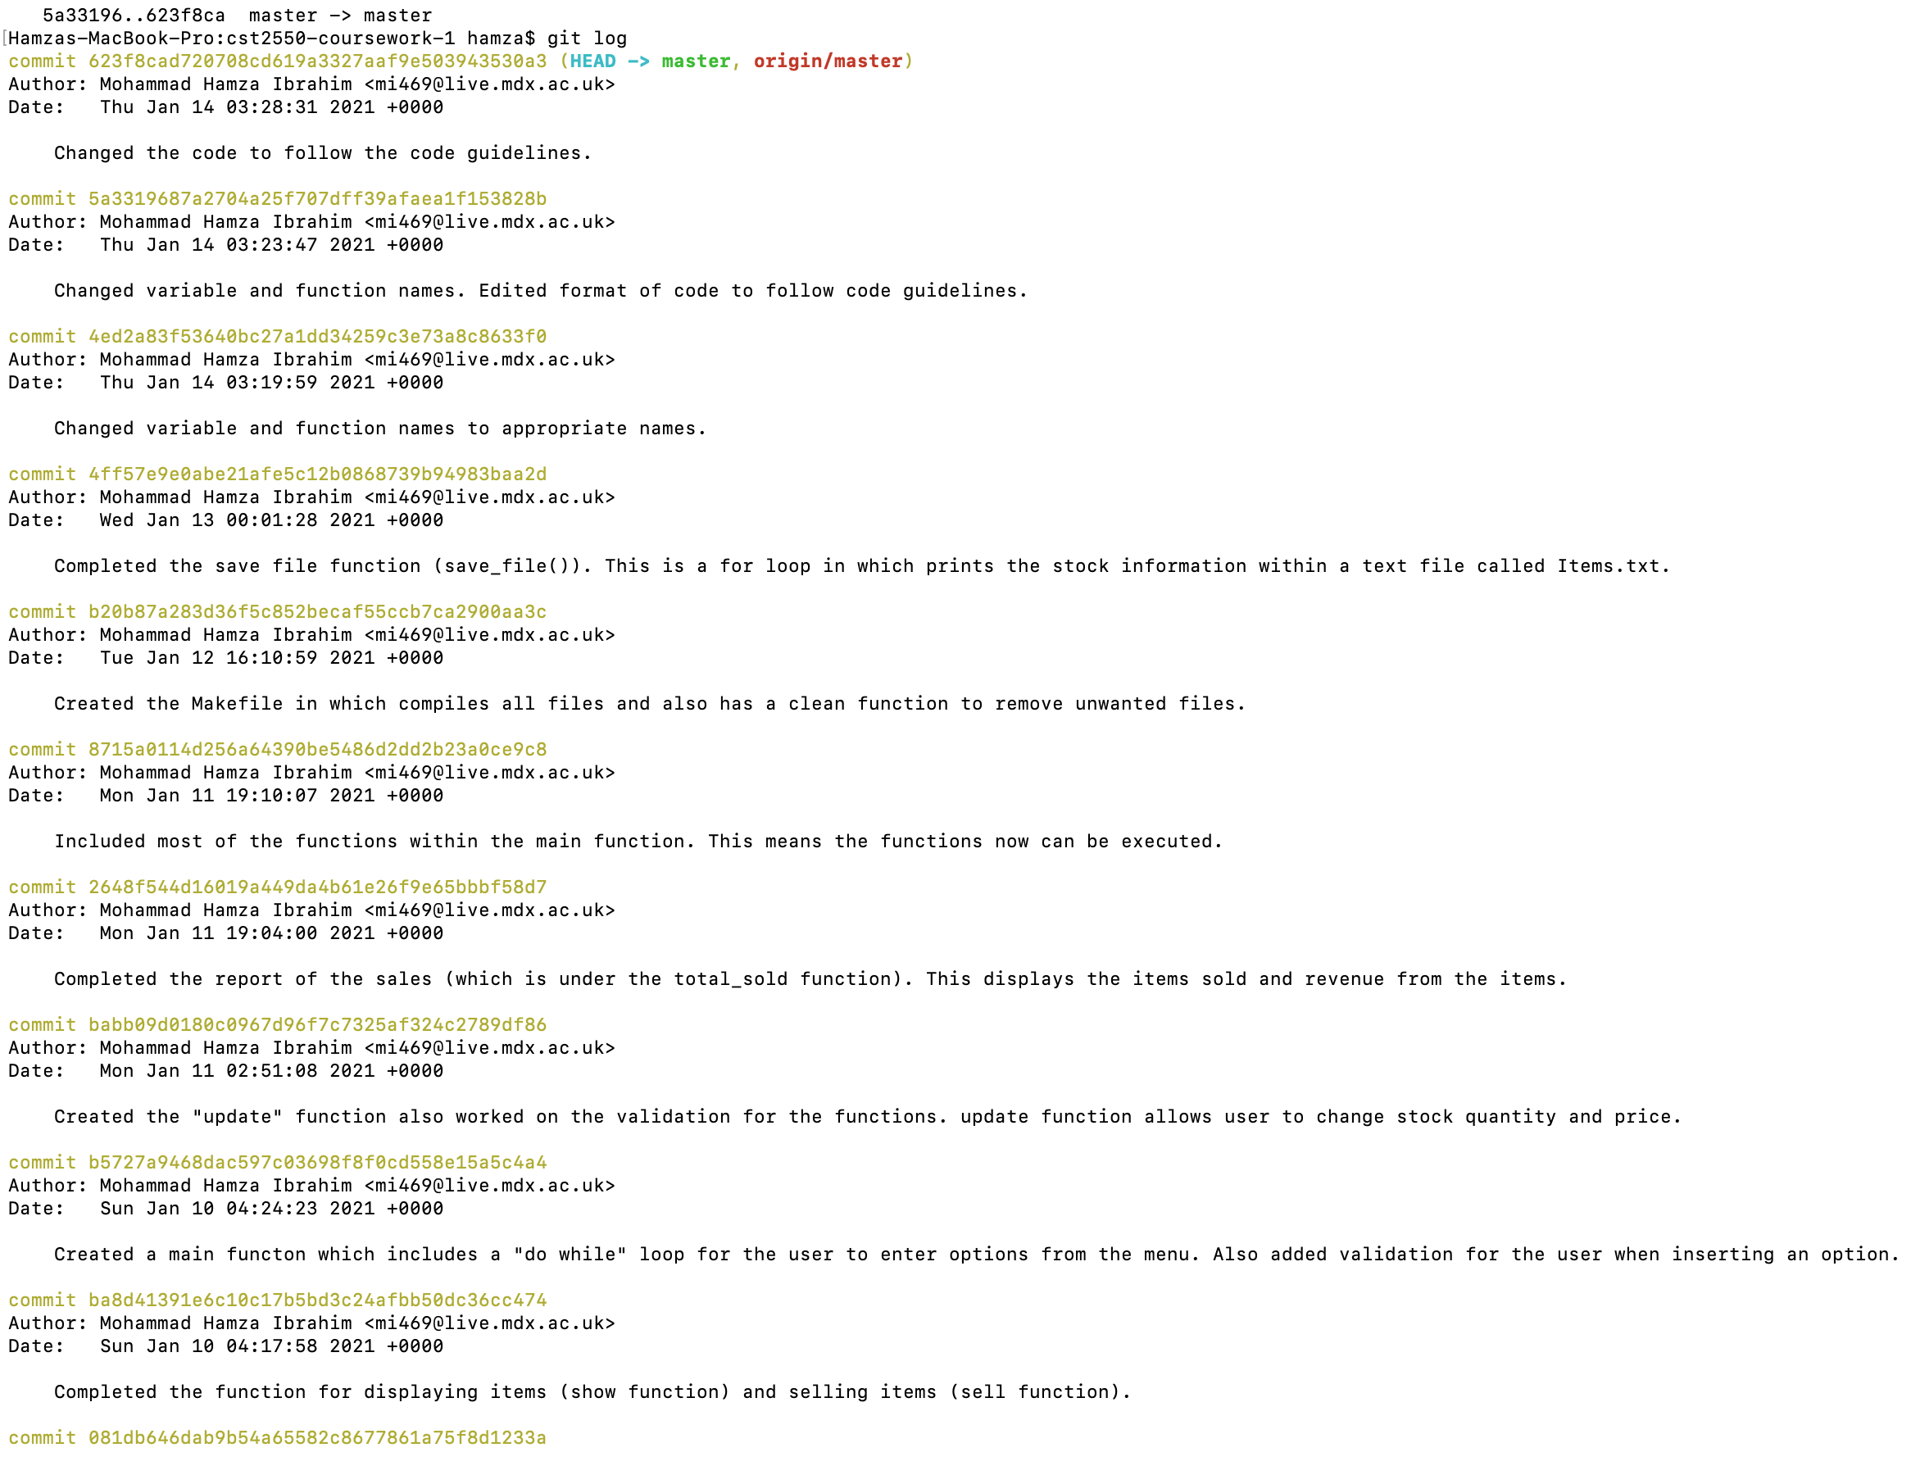
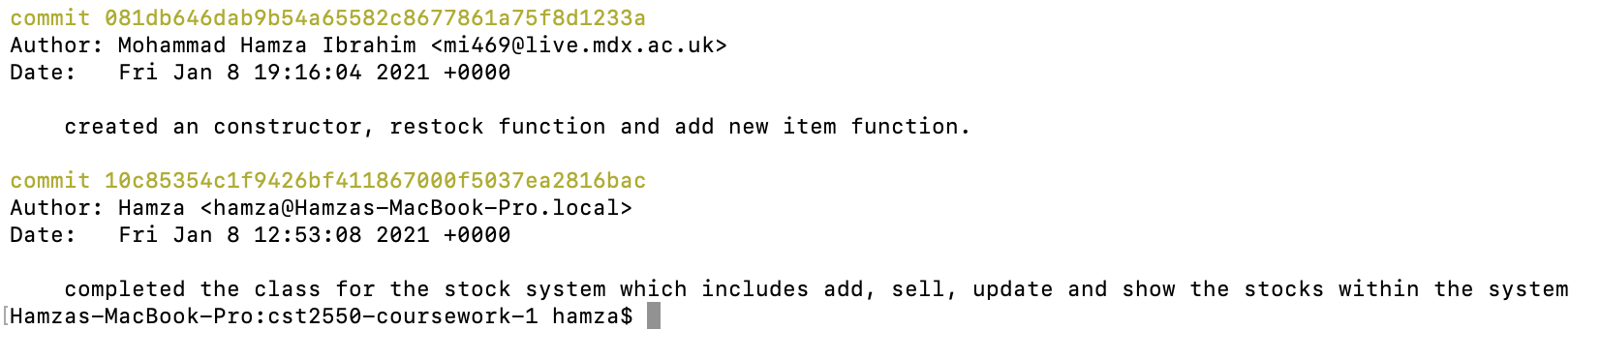
commits

Slide 20
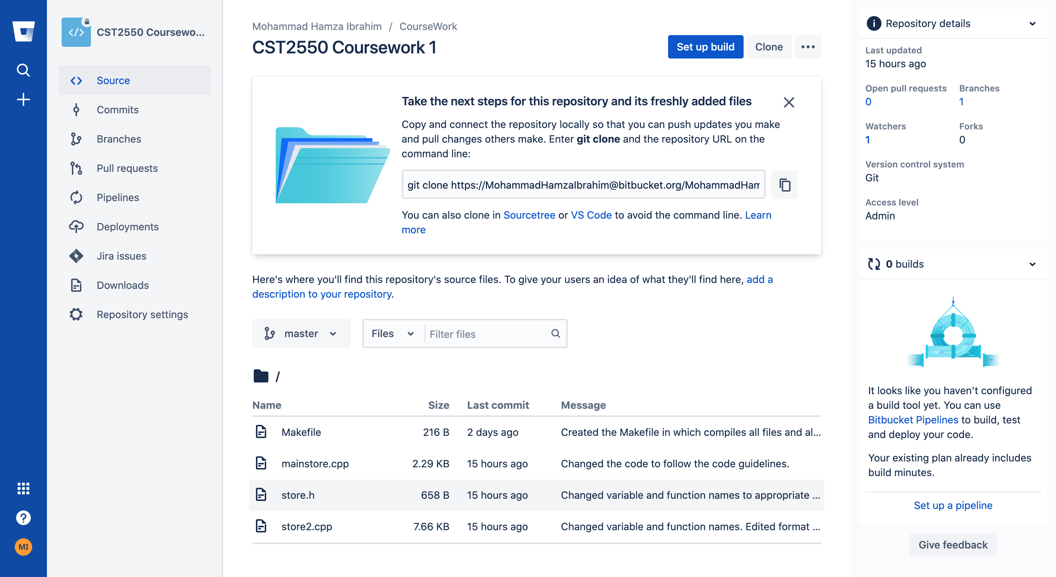
commits

Slide 21
Implementation
The approach I used was to use the UML diagrams to aid me creating the code for the system (which is writen in previous slides). I then used testing in early stages since it not only prevents complicated errors in the future but also it allows me to keep track on where the error is.
As soon as I created all files needed, I created the makefile. This Only compiles files which have changed and compiles in order making it more efficient . Within the makefile I have used Automatic Variables to reduce the need for typing. I have also added a clean function in order to remove unwanted files from the compilation. I also used PHONY to prevent any confusion of file compilation.
For the version control I used distributed version control since I used git to monitor my work. I also used branching which Creates a separate line of development. This allowed me to try out possible features without effecting the current release.

Slide 22
Limitations
The main limitation is within the testing aspect of my project since I have not tested with a framework such as catch. If this was done this would have validated my system hugely and would have shown you my knowledge of testing.
Another limitation is that within my system the stocks are not categorized. For example, the stocks for DVD’s are not grouped together and so on.
Apart from those limitation I think I have cover everything else within the coursework sheet.

Slide 23
Conclusion
Summary:-
Within this presentation I have shown you the approach that I have taken for this project.
Presented and explained the UML diagram as well as shown you how this linked with my system.
Shown you screenshots on the commits and BitBucket repository
I have demonstrated the testing that I have done.
If I was to do this again, I will do more testing with catch (framework). I will also carry huge research before hand in order to make sure I can follow the UML diagrams.

Slide 24
Resources used
https://www.youtube.com/watch?v=pCK6prSq8aw
All lecture slides
https://stackoverflow.com/questions/25475384/when-and-why-do-i-need-to-use-cin-ignore-in-c
https://www.youtube.com/watch?v=_IzYGiuX8QM&list=PLmwMnplCbVihAHydDxBiDgzxsha1c_sxV&index=44
https://www.youtube.com/watch?v=lzxWNtjii8U
Stackoverflow
https://www.researchgate.net/figure/UML-Class-Diagram-for-Inventory-System_fig2_268209199
https://www.youtube.com/watch?v=zid-MVo7M-E
https://www.youtube.com/watch?v=UI6lqHOVHic

